Slide 1

Note for the teachers not for the students.
Dear colleagues,
I like to draw your kind attention that it will be better for you to read the instructions below the pages before going to stat your presentation to make the class effective.
Your near & dear
Md. Hasan Hafizur Rahman
Notes:
Reminder to my dear colleagues to read the instructions before going to present the class.

Slide 2
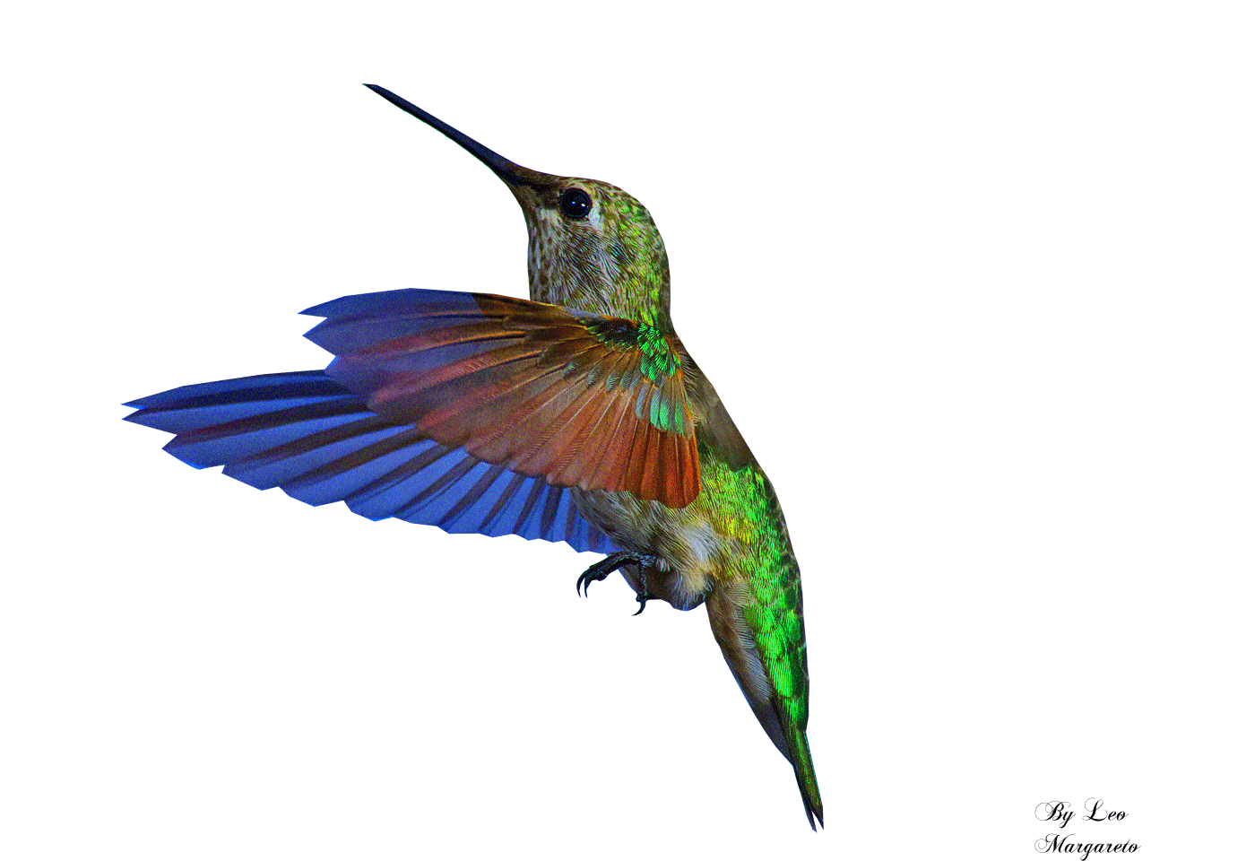
Welcome to the world of HHR multimedia presentation
Notes:
Just to attract students’ attention I added this welcome slide. Teacher may change it if he thinks.

Slide 3



Introduction
Md. Hasan Hafizur Rahman
Lecturer & Head of the Department (English)
Cambrian School & College,
Building-5, Dhaka,
English For Today
Class IX-X
Notes:
Introduction of teacher & class.

Slide 4


Observe and guess the video
What have you observed in the video?
Different professions / different jobs/Job around us.
Let us see what our
today’s topic is.
Notes:
The video is for taking out the lesson from the students. Just you may go according to animation.

Slide 5

Our Today’s topic is
Job Around
Unit-9, Lesson-1
Notes:
Lesson declaration.

Slide 6
Learning outcomes
After studied this topic we will be able to-
ask and answer question
read and understand text through silent reading
write a paragraph
Notes:
All the four skills will be focused in this lesson.

Slide 7
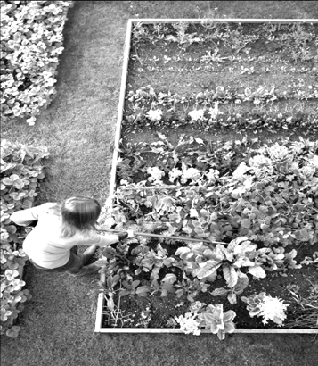
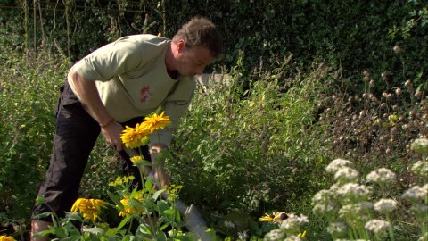
A Many of us think that we must have a steady big job to be happy in life. Is that always true? Look at the picture and discuss in pairs what you see in it.
Notes:
It is a pair discussion just for two or three minutes to say something by the learners to practice speaking skill.

Slide 8
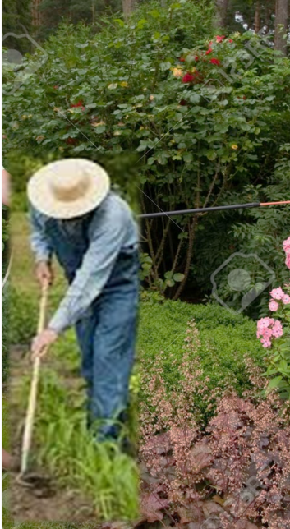
Let us introduce with a person and his activities.
was a desk clerk.
He did not like official job.
It was boring to him.
He had a good salary.
Yet he left the job after two years.
Now he is the owner of a nursery.
He works here as a full time job.
Sayeed Kamal
Notes:
Some initial information transfer to the learners from the text.

Slide 9
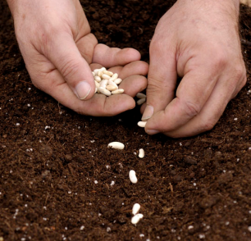
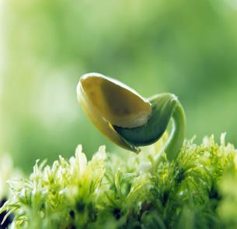
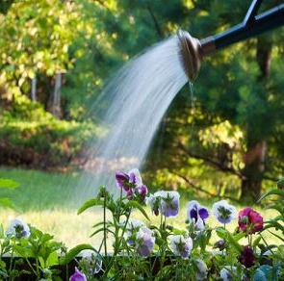
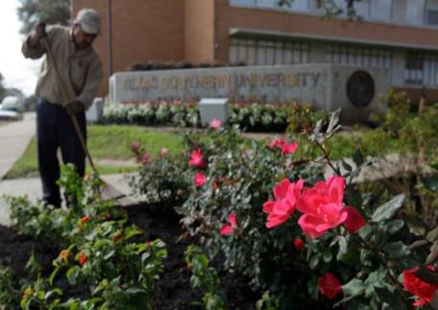
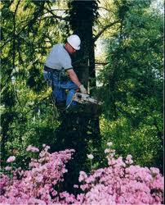
He spends his times planting -------------
seedlings
budding
caring plants
cleaning flowers’ bed
passing time with trees
Notes:
Task of Sayeed kamal is focused here.

Slide 10
Key words/new words option
Try to answer the meaning of the word, see the pictures , check what you have told then make a sentence with the main word.
Notes:
Teacher may go according to the animations to conduct this session.

Slide 11
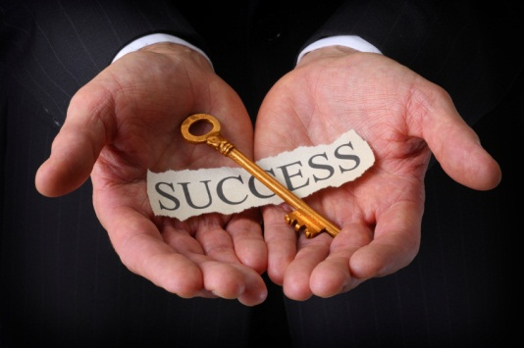
Entrepreneur
Meaning : Businessperson/magnate
Sayeed Kamal is a successful entrepreneur.
Notes:
Teacher may go according to the animations to conduct this session.

Slide 12
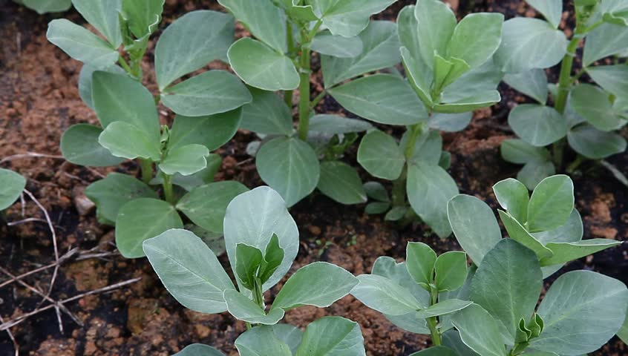
Saplings
Meaning: little plant/seedlings
The saplings look green.
Notes:
Teacher may go according to the animations to conduct this session.

Slide 13
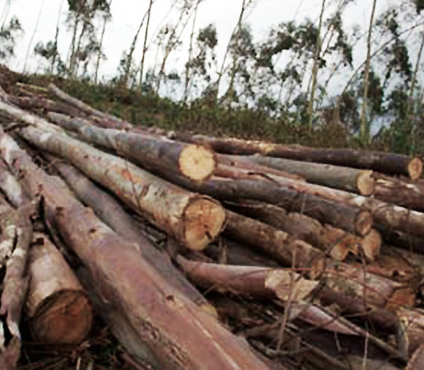
Timber
Meaning
Logs/wood
We use timber to make furniture.
Notes:
Teacher may go according to the animations to conduct this session.

Slide 14
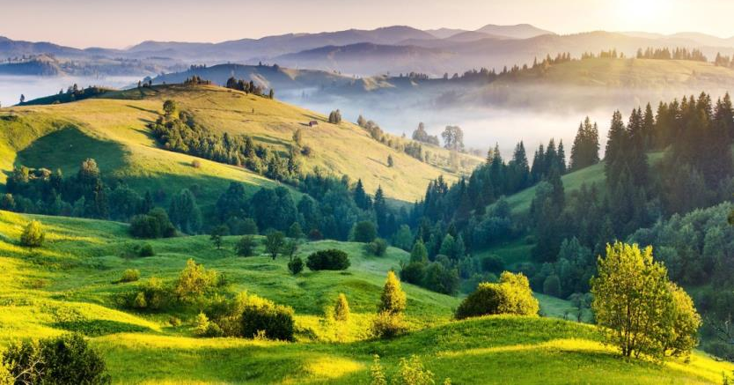
Countryside
Meaning: Horizon/rural area/ green field
I visit my countryside on Friday.
Notes:
Teacher may go according to the animations to conduct this session.

Slide 15
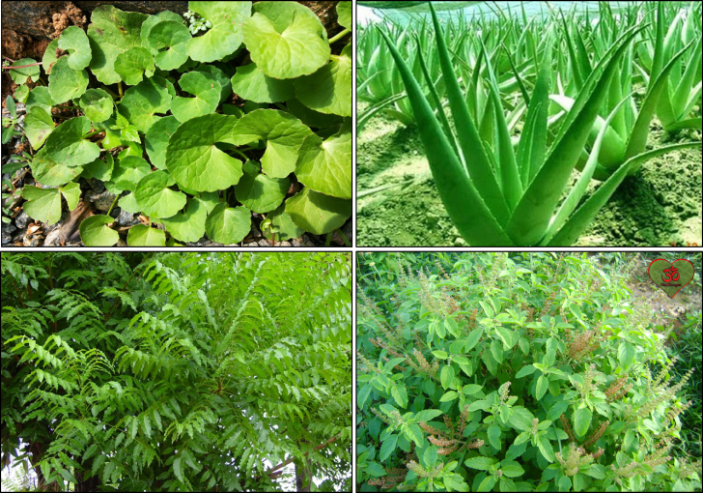
Medicinal Plant
Meaning
Plant used to produce medicine
Thankuni
Aloe Vera
Neem
Tulshi
We find medicine from medicinal plants.
Notes:
Teacher may go according to the animations to conduct this session.

Slide 16
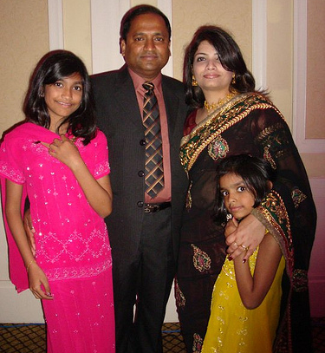
Decent life
Meaning
Civilized/ polite/respectful/ gracious
Everyone likes to lead a decent life.
Notes:
Teacher may go according to the animations to conduct this session.

Slide 17
B Read the text. It is about a young entrepreneur, Sayeed Kamal. Notice what he thinks about job and happiness. Then answer the questions that follow.
I know you will wonder if I say the best thing that ever happened to me was when I lost my last job. Yes, really!
I was a desk clerk in an office. But believe me I never liked my job. Nothing can be more boring than being stuck in an office all day with computers and telephone.
So after two years or so, I decided to leave my job though I had good salary there. Now I'm an owner of a nursery. Planting seeds, budding, grafting, taking care of saplings, cleaning the flower beds and spending time with trees are my full time job. I start work very early. In summer I usually leave home at 5:30 in the morning, but in winter not until about 7. I've & small hut in my nursery. There cannot be any more pleasure for me when I see the moon from there or walk through the trees in the soft moonlit night. The winter is just over. So I'm cleaning up the winter flower garden. Now I'm busy in producing more timber and medicinal plants which people will buy from July. Every season is so different and 1 love them all. When I compare my present days with the past, I simply can't understand how I could survive there in my previous job. I love nature.
Notes:
Teacher may conduct this option manually. This is just for the students who have no text book with them. Teacher may conduct this page as loud reading. He may read out it loudly with proper pronunciation, stress and intonation along with necessary grammatical term.

Slide 18
I just love working outside in the open air after all those months in a stuffy office. Gadgets never attract me and perhaps will never.
I'm not married. I do my own work even cook my own food. I try not to depend on others for the work which I myself can do. Often my friends are annoyed with me. They say, I should engage a maid for household chores. They are not happy to see me in this 'rustic life'. They are professionals. They earn a lot. Maybe — much more than me but I think I enjoy my work more.
At weekends, I often go countryside. Sometimes with my friends, sometimes alone. I love collecting unknown saplings. I have another hobby. I love collecting stamps. I have a Russian stamp during the period of Lenin. I don't watch TV. Almost everyone has a TV set these days. But I don't have any. How is that?
The only problem I face is I do not earn enough money in all seasons. The winter and the rain are two busy seasons for me. But it's OK. Maybe I do not earn enough like many other people around me. But I at least earn enough for my family, employees, and me to run a decent life. I must say I'm a very happy man!
Notes:
Teacher may conduct this option manually. This is just for the students who have no text book with them. Teacher may conduct this page as silent reading by the students.

Slide 19
Questions
1 What is the best thing that ever happened to this man?
2 Why does Kamal like his job?
3 What is the problem with his job?
4 When does he earn most money?
5 What attitude do you find here in Kamal when you read these lines ‘Maybe I do not earn enough like many other people around me. But I at least I earn enough for my family, employees, and me to run a decent life’?
Notes:
This is evaluation session. Teacher may conduct it orally or written if time covers.

Slide 20
C Ask and answer questions about Kamal. Use the clues given.
Example:
…………………………… married?
Q: Is he married?
A: No, he isn’t. He isn’t married.
1 ……………….. happy?
2 When…… leave home in summer?
3 What …….. plant after winter?
4 What ……. do at the weekend?
5 What …….. collect?
Notes:
Teacher may go according to the direction of the text.

Slide 21
D Look at the following table. The left column shows some positive aspects of Sayeed Kamal’s character. Add some more to the list. Also find out some aspects of Sayeed that you think unacceptable and write them in the right column.
Good aspects of Sayeed | Unacceptable aspects of Sayeed
a. Simple b. Diligent c. Loves nature d. Caring e. f. g | a. old fashioned b. loner c. d
Notes:
Teacher may conduct according to the direction of the text.

Slide 22
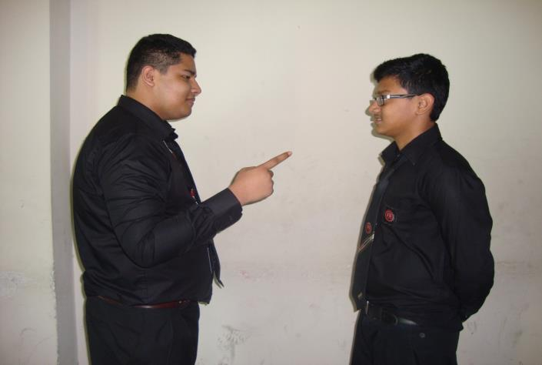
E Write a paragraph on Sayeed Kamal. Take your cues form D.
F ‘I must say I’m a very happy man!’--- Do you agree with Sayeed? Write why/why not?
Notes:
Teacher may go according to the direction of the text.

Slide 23
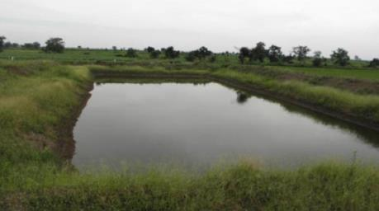
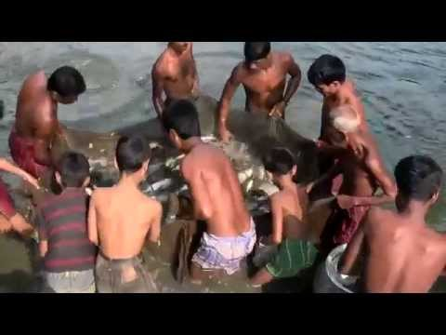
Home Assignment
Suppose Mr. Hasan is an educated man. He had an official job. Leaving the job he started fish cultivating and became a successful man. Now write an article on his life and activities in 150 words.
Notes:
Just to practice writing skill it is suggested. Teacher may give a guideline to the learners showing the pictures and direction above to write an article about Mr. Hasan.

Slide 24
Bye bye. See you again.
Notes:
Ending slide. Just one click.

